Slide 1
Week 3
Inflation Targeting Part 3
Dealing with the Zero Lower Bound

Slide 2
From previous lecture: the problem
Interest rates cannot go materially below zero
Why?
substitution into currency
public resistance to negative deposit rates
effect on bank profits
But, zero might not be low enough to counteract a severe recession
This means the economy could conceivably get caught in a debt/deflation spiral

Slide 3
Lecture outline
Bernanke (2002) on possible solutions
A case for overt monetary financing (Turner)
Negative interest rates as an alternative solution to the ZLB (Rogoff)
next week

Slide 4
Bernanke on fighting deflation
Prevention better than cure: aim for a buffer of inflation above zero
Use regulatory policy to promote financial stability (avoid financial stress and excessive debt)
Two plausible-sounding metaphors with opposing implications:
save your ammunition, or
fire the bullets while they still work?
Bernanke says the second one is correct
‘save your ammunition’ is a plausible-sounding fallacy

Slide 5
Curing deflation if prevention fails (Bernanke)
Central proposition: fiat money can be created at essentially zero cost.
(The mechanism: money-financed fiscal expansion)
Therefore its value can be debased by expanding supply sufficiently aggressively
this shifts us from rate-setting (normal times) to quantity setting (emergency times)
The main problem in doing this once you reach ZLB is calibration, not effectiveness (risk of overdoing it)
Also there is the problem of overcoming legal/political safeguards against inflationary finance

Slide 6
Bernanke’s menu of policy options at ZLB
Purchase longer-term government securities to flatten the yield curve
Announce caps for longer-term interest rates
Use CB balance sheet to buy foreign government securities (equivalent to exchange rate intervention to depreciate the currency)
Money-financed tax cut/benefit payment (= Friedman’s “helicopter drop”)
Bernanke’s comment on Japan: obstacles to such policies are political rather than technical or economic

Slide 7
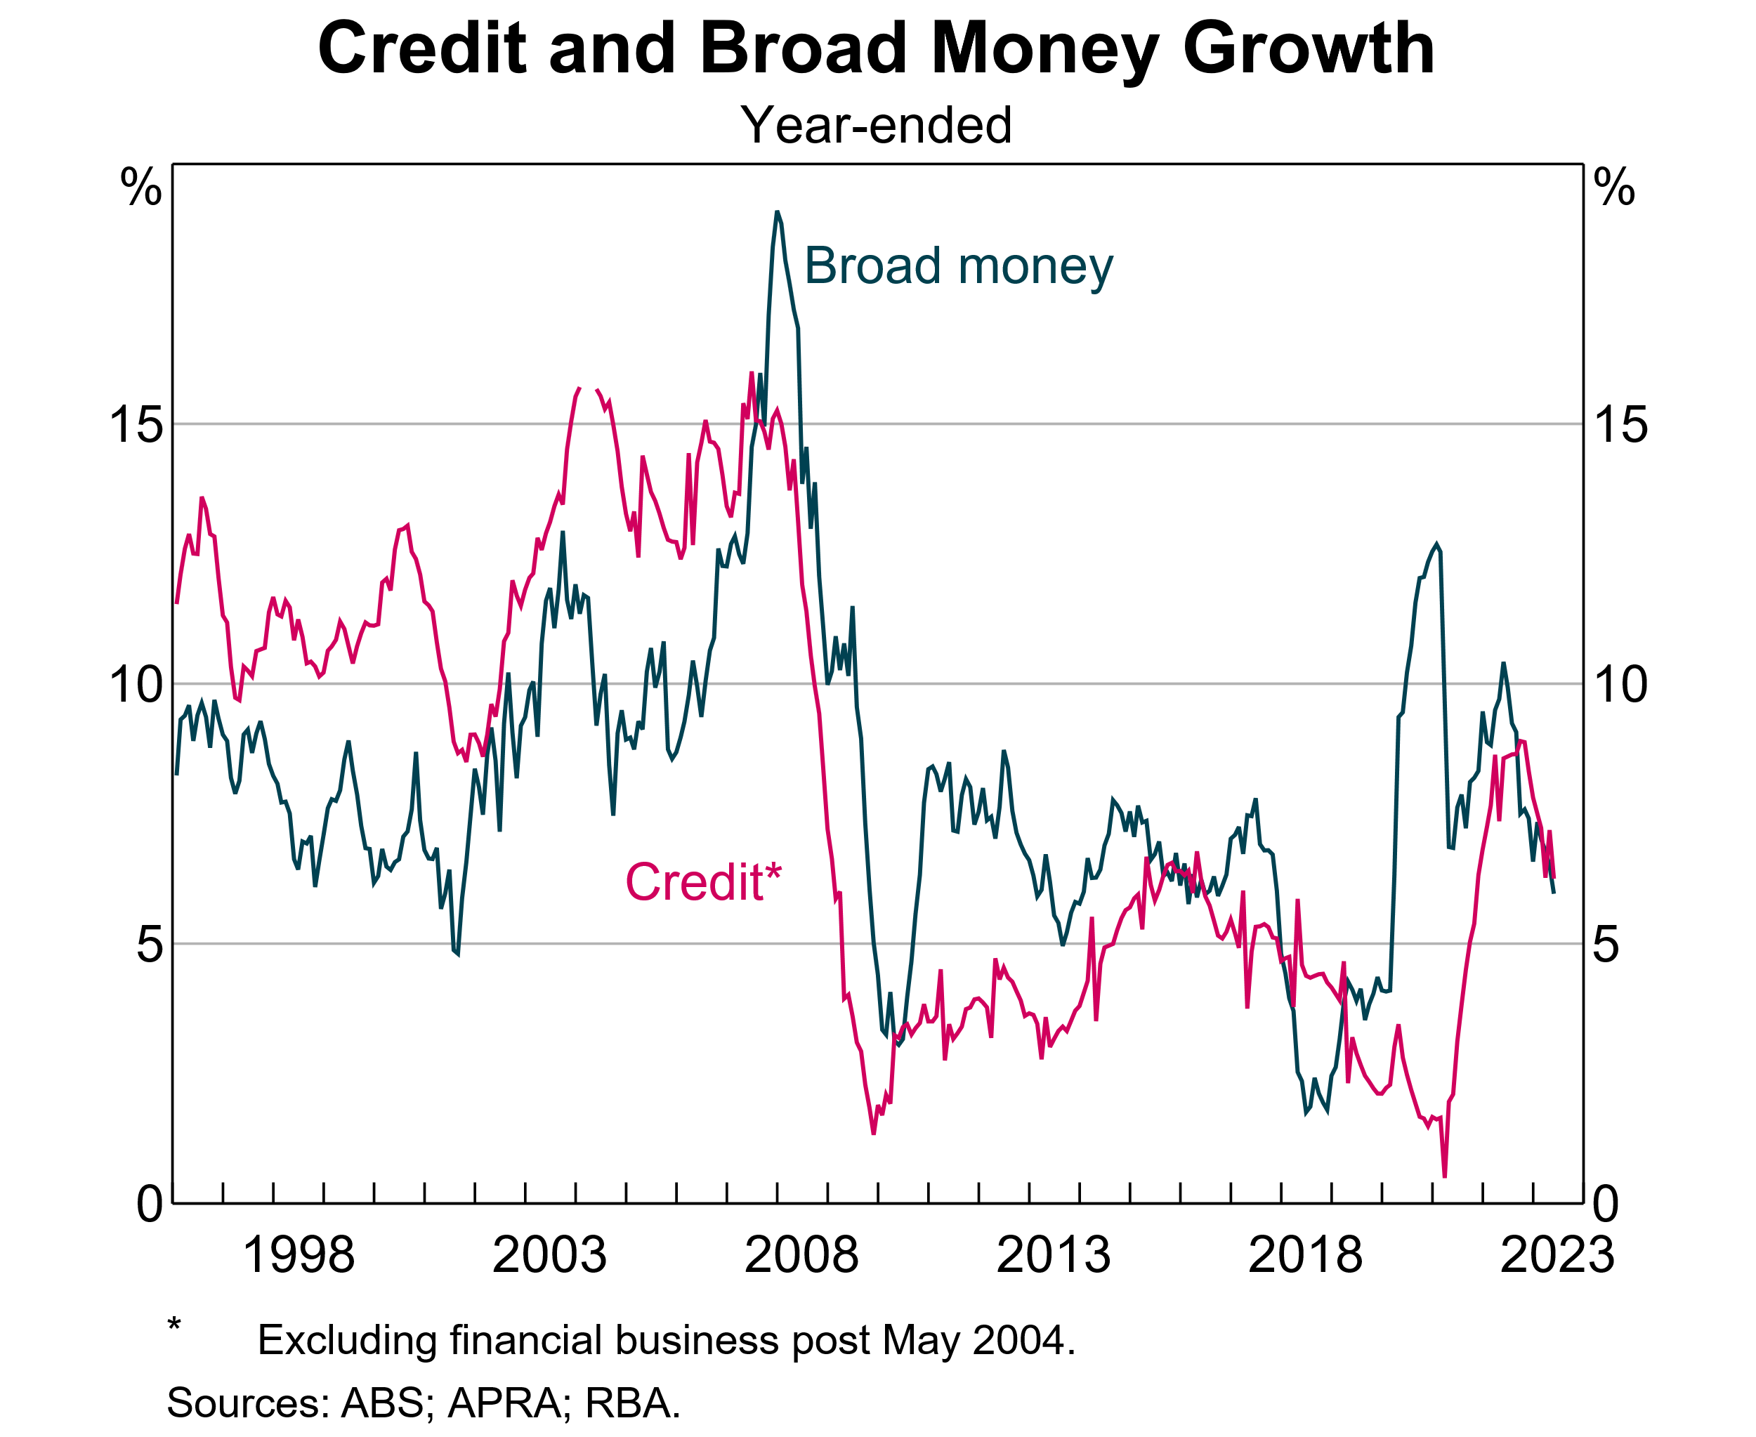
Stylised impact of fiscal expansion + QE
Assumptions:
Government makes $100bn in additional payments to households
RBA undertakes $100bn in QE bond purchases
Balance sheet impacts:
RBA
Commercial banks
Assets ($bn) | Liabilities ($bn)
CGS + 100 | Bank reserves +100
Assets ($bn) | Liabilities ($bn)
Reserves at RBA +100 | Customer deposits + 100

Slide 8
Subsequent debate after Bernanke
After GFC, ZLB problem became generalised (approx. 2009 – 2021)
Key elements of the Bernanke prescription became widely accepted, in a somewhat expanded form:
quantitative easing (QE) through CB asset purchases. Aim: to flatten the yield curve, expand liquid assets of the banking system, promote bank lending
credit easing. Targeted purchase of non-government credit instruments to improve market liquidity and narrow risk spreads in dysfunctional markets
enhanced signalling of CB intentions. Promote confidence that interest rates will remain low (note: relevance to Australia)
direct CB lending to banks, and incentives for banks to lend
interest rates below zero (slightly) in some jurisdictions

Slide 9
Two Bernanke recommendations not widely accepted
Exchange rate intervention/depreciation
international spillovers
not a solution for world as a whole
“Helicopter money” – regarded as controversial in central banking circles, but was increasingly talked about in lead-up to Covid-affected period
money creation as a last-resort expansionary weapon

Slide 10
Covid impact on monetary policy debate
A central question at the time of the Covid outbreak (early 2020):
how to provide additional stimulus, if needed, in a renewed downturn, starting from ZLB?
Actual policy response: a combination of
fiscal stimulus
CB bond purchases
Since late 2021, the focus of CB debate and criticism has shifted rapidly back towards need for inflation control
did policy-makers overdo the stimulus??

Slide 11
Turner’s paper on ZLB
Turner (2013) was writing after the GFC, thinking ahead to the next downturn
The problem:
ZLB had been reached in major advanced economies: UK, US, Japan, euro area
more stimulus required to promote recovery
debt overhang, both public and private
fiscal limits may have been reached
standard QE tools promote more financial risk taking

Slide 12
Turner’s position
Supports the original Bernanke menu of options
Introduces the terminology Overt Money Finance (OMF) (subsequently not widely adopted by others)
OMF = coordinated monetary/fiscal expansion
= “helicopter money”
Argues against taboo on OMF, but subject to safeguards
Argues that OMF is consistent with longstanding monetary orthodoxy (eg early Friedman)
Friedmanite targets designed to avoid both deflation and inflation

Slide 13
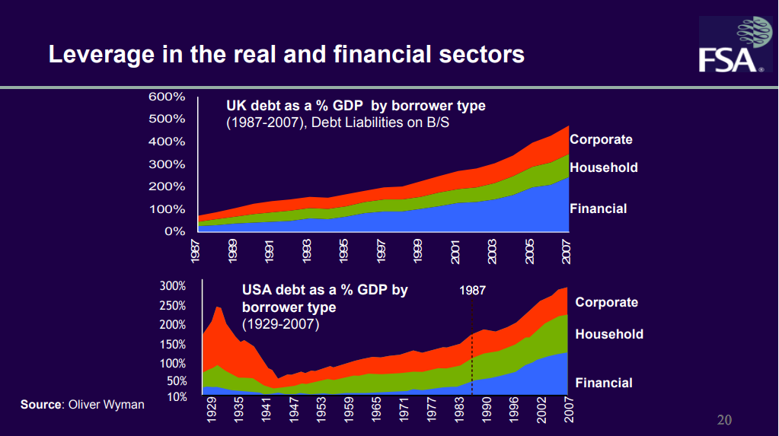
GFC vulnerability caused by build-up of excessive leverage

Slide 14
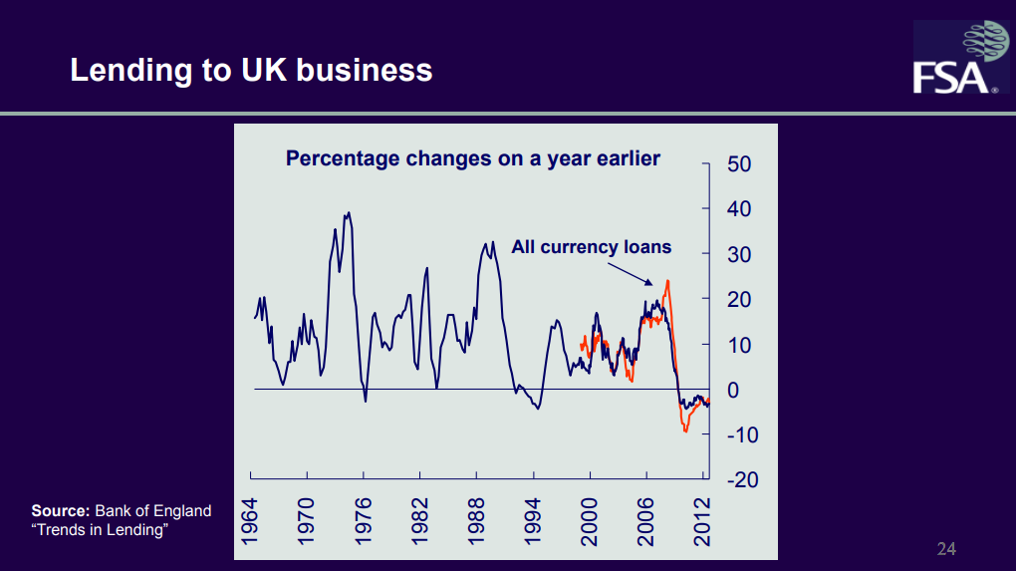
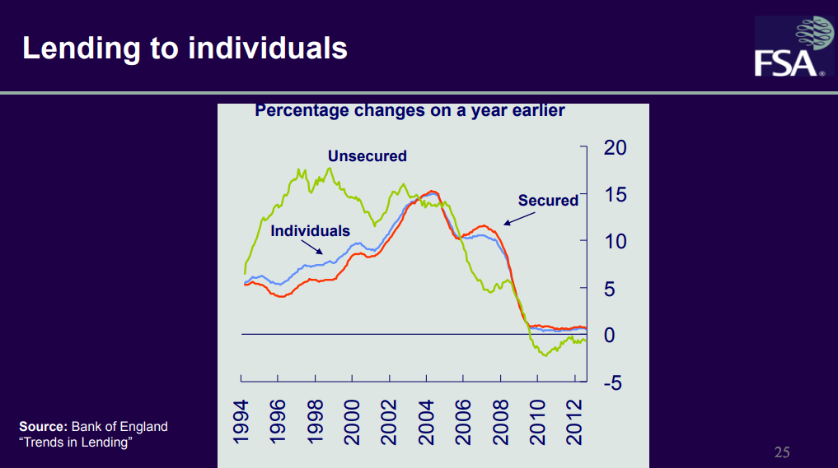
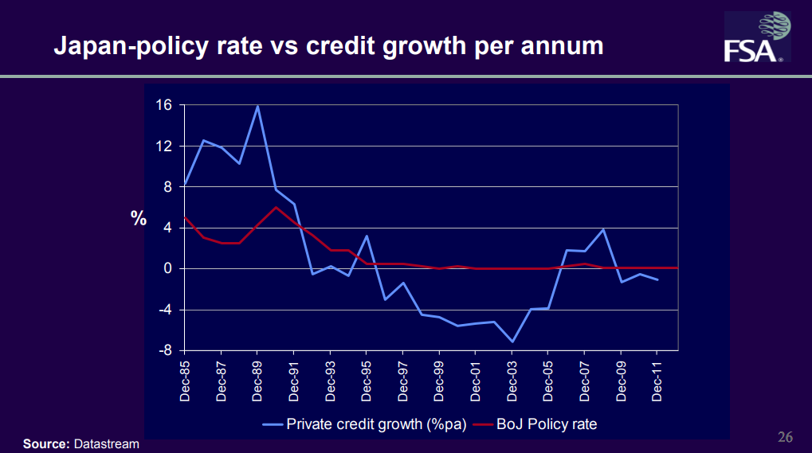
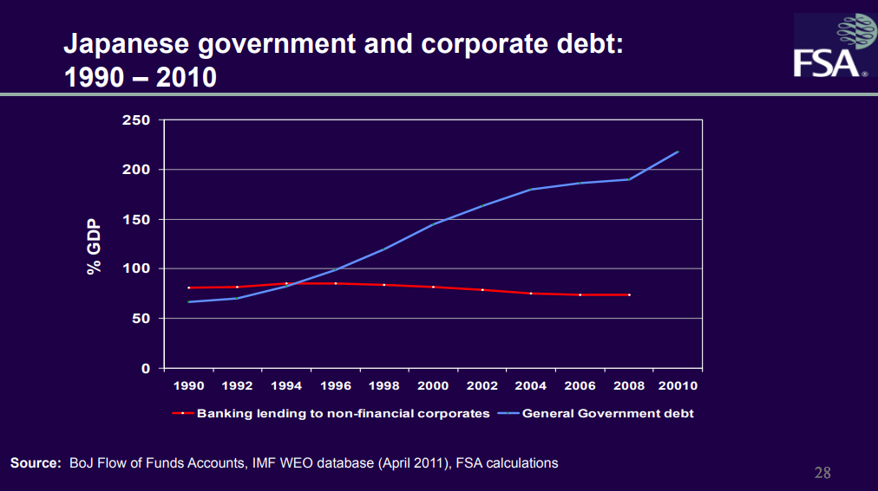
Some impacts of GFC

Slide 15
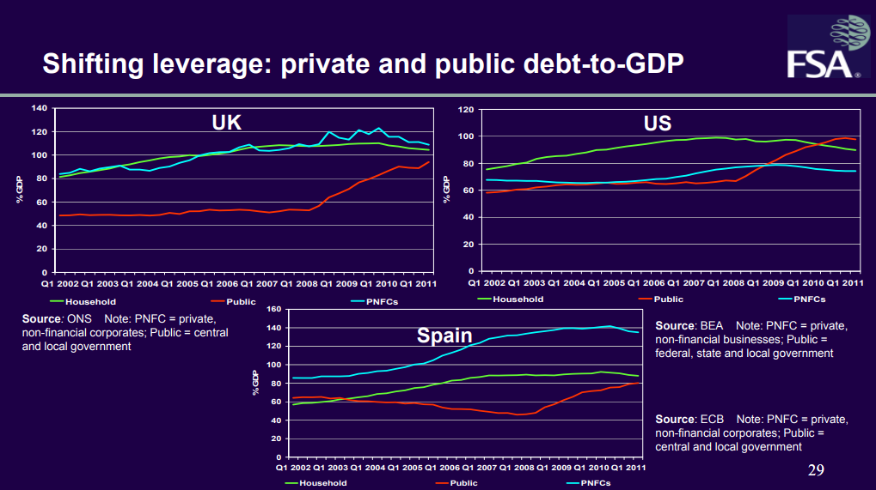
Public and private sector debt

Slide 16
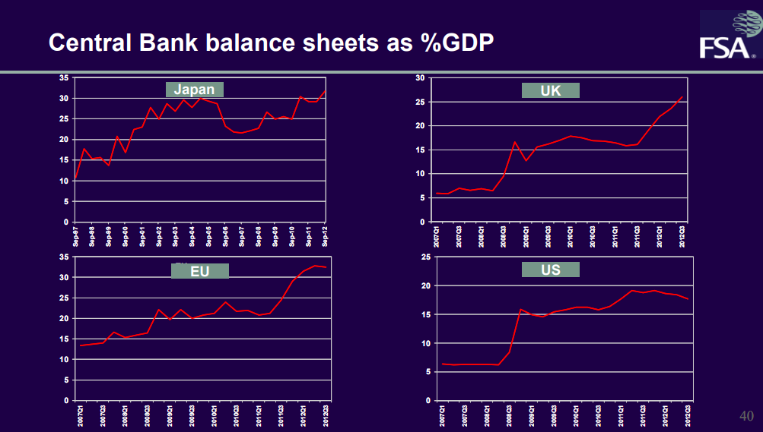
Expansion of CB balance sheets as a result of QE

Slide 17
Turners arguments in favour of OMF
Conventional instruments unavailable or ineffective
Fiscal limits reached
Need to raise nominal GDP due to debt overhang
Credit easing promotes risk-taking when debt is already too high
OMF would be effective
Consistent with classical monetary theory (Friedmanite orthodoxy)

Slide 18
Some common arguments against OMF
Inflationary/irresponsible
Risk of excess/loss of discipline
Breaks longstanding safeguards against inflationary finance of the government
Hard to calibrate:
expansion phase
reversal phase

Slide 19
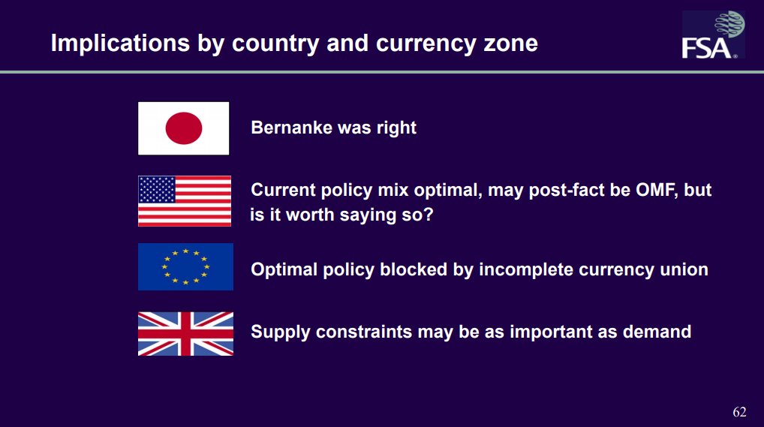
Implications/conclusions 1

Slide 20
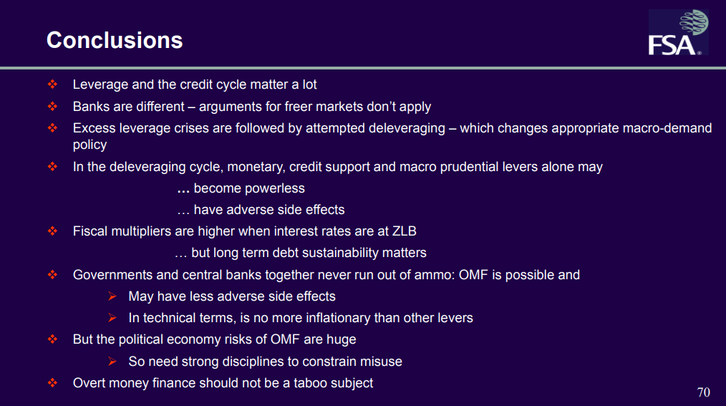
Implications/conclusions 2

Slide 21
Final points on ZLB/OMF/Helicopter money
This debate is still not settled
It gained added relevance during the Covid-affected downturn
De facto helicopter money may be argued to have occurred:
expansion of fiscal deficits, indirectly financed by the CB
Debate in 2022-23 quickly shifted to the question: was the stimulus too much?
Will come back to this as a final topic at the end of the course

